Slide 1
Graphs
Chapter 8

Slide 2
Objectives
Graphs
Graph Representation
Graph Traversals
Connectivity
Cycle Detection
Shortest Paths
Dijsktra algorithm
Floyd algorithm
Bellman-Ford algorithm
Spanning Trees
Kruskal algorithm
Dijktra algorithm
Eulerian and Hamiltonian Graphs
Graph coloring
Reading at home
Notes:
Note: (*) Means that students are required to understand essential features only (the problem explanation, definitions, the outline of algorithms…), not in details.

Slide 3
Bellman-Ford Algorithm

Slide 4
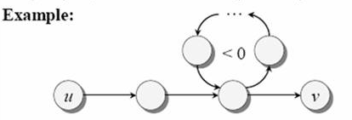
Negative weight cycles
Recall: If a graph G=(V, E) contains negative weight cycle, then some shortest paths may not exist.
Bellman-Ford algorithm:
Find all shortest-path lengths from a source s in V to al v in V
Or determines if there’s a negative-weight cycle

Slide 5
Bellman-Ford algorithm
d[s] = 0;
for each v in V - {s}
do d[v]=infinity
for i=1 to |V| - 1 do
for each edge (u, v) in E do
if d[v] > d[u] + w(u,v) then
d[v]=d[u]+w(u,v)
p[v]=u
for each edge (u,v) in E do
do if d[v]>d[u]+w(u, v)
then report that a negative-weight cycle exists
Initialization
Relaxation

Slide 6
Bellman-Ford Algorithm
-3
 | S | A | B | C | D | E
0 | 0 | inf | inf | inf | inf | inf
1 | 0 | -4(S) | inf | inf | inf | -3(S)
2 | 0 | -4(S) | inf | -5(A) | -6(A) | -3(S)
3 | 0 | … | … | … | … | …
4 | 0
5 | 0
6 | 0
S
6
-4
C
4
-1
A
E
-2
2
8
D
-3
B
3

Slide 7
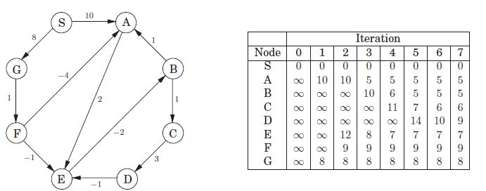
Example

Slide 8
Spanning Tree

Slide 9
Definition
Spanning tree is a tree in which
There is an algorithm that guarantees generating a tree (or a forest, set of trees) that includes or spans over all vertices of the original graph

Slide 10
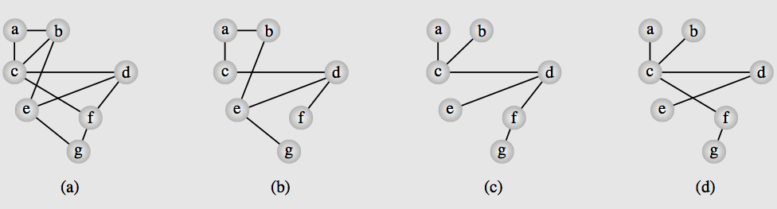
Example
Example, there is a graph (Fig. a) representing airlines among 7 cities
For some reasons, it’s forced to close several lines
Still there must be a connection (direct/indirect) any two (Fig. b, c, d)
Close as many as possible (Fig. c, d)
The minimum number of such connections form a tree
Coz, alternate paths arise as a result of cycles in the graph
Spanning tree is by product of depthFirstSearch()
We can create different spanning trees for a graph (c, d)

Slide 11
Minimum spanning tree
Example above, cannot get better than 6 edges
The solution to this problem is not optimal
Distances between cities have not been taken into account
We can use cost of these connections to choose the best, guaranteeing the optimum cost
Can be done by having minimum short distances for six (example above) connections
So now the problem is called Minimum Spanning Tree
Spanning tree with sum of the weights is minimal.
In a simple graph with weight =1, every spanning tree is a minimum spanning tree

Slide 12
Kruskal
Spanning Tree

Slide 13
Kruskal: Minimum spanning tree
Minimum spanning tree problem has many solutions
A popular one is from Joseph Kruskal.
All edges are ordered by weight
Each edge in this ordered sequence is checked to see whether it can be considered part of the tree under construction
It’s added to the tree if no cycle arises after inclusion.

Slide 14
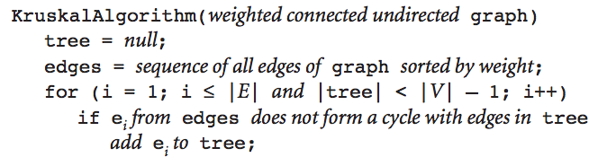
Kruskal: the algorithm

Slide 15
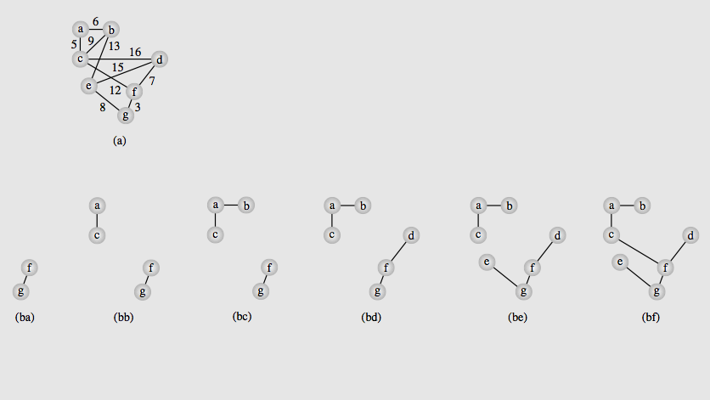
Kruskal: Example

Slide 16
Dijkstra - Prim
Spanning Tree

Slide 17
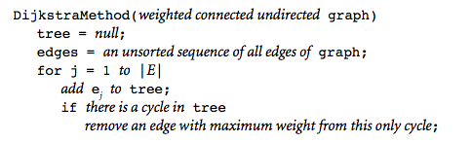
Dijkstra Algorithm
Kruskal’s algo requires edges to be ordered first
Dijkstra (1960) and independently Robert Kalaba
Tree is expanded by adding to it edges one by one
Once a cycle is detected
Edge in this cycle with maximum weight is discarded

Slide 18
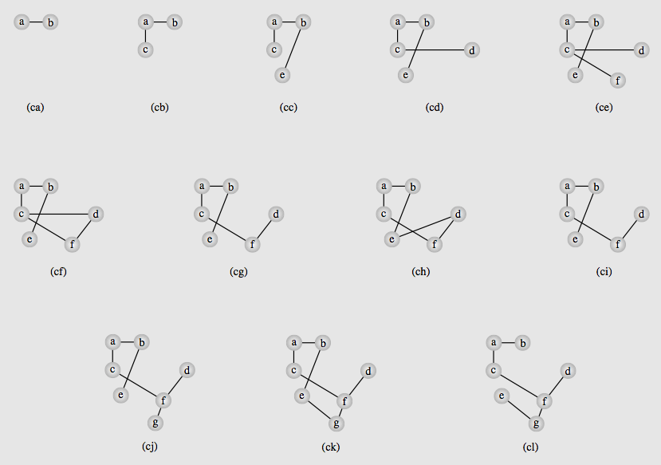
Dijkstra Algorithm Example

Slide 19
Eulerian and Hamiltonian Graphs

Slide 20
Terminologies
Euler path: a path traversing all the edges of the graph exactly once
Euler cycle: a cycle traversing all the edges of the graph exactly once
Hamilton path: a path traversing all the vertices of the graph exactly once
Hamilton cycle: a cycle traversing all vertices of the graph exactly once

Slide 21
Eulerian Graphs

Slide 22
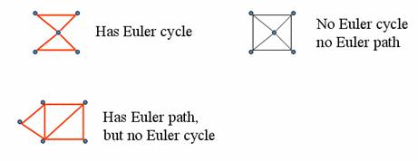
Examples
1
1

Slide 23
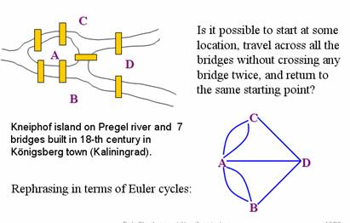
Examples

Slide 24
Theorem 1: Sufficient condition
A connected multigraph has an Euler cycle if and only if each of its vertices has even degree
Proof sketch, PART 1 (Necessary condition):
Assume the graph has an Euler cycle
Observe that every time the cycle passes through a vertex, it contributes 2 to the vertex’s degree
Since the cycle enters via an edge incident with this vertex and leaves via another such edge.

Slide 25
Theorem 1: Sufficient condition
Proof Sketch, PART 2 (Sufficient condition):
Demonstrate an algorithm for finding Euler cycle in a graph where all vertices have even degrees
Assume every vertex in a multigraph G has even degree.
Start at an arbitrary non-isolated vertex v0, choose an arbitrary edge (v0, v1)
Then choose an arbitrary unused edge from v1 and so on.
After a finite number of steps the process will arrive at the starting vertex v0, yielding a cycle with distinct edges.
If the cycle includes all edges of G, this will be an Euler cycle;
If not, begin the procedure again from a vertex contained in this cycle and splice the two cycles together; continue until all edges are used.

Slide 26
Theorem 1: Sufficient condition
In the above procedure, once you entered a vertex v,
There will always be another unused edge to exit v because v has an even degree.
The only edge from which you may not be able to exit after entering it is v0
But if you have reached v0, then you have already constructed a required cycle.

Slide 27
Procedure for constructing an Euler cycle
Algorithm Euler(G)
Input: Connected graph G with all vertices having en degrees
Output: Euler cycle
Construct a cycle in G
Remove all edges of cycle from G to get subgraph H
While H has edges
find a non-isolated vertex v that is both in cycle and in H
//The existence of such vertex is guaranteed by G’s connectivity
construct subcycle in H
splice subcycle into cycle at v
remove all the edges of subcycle from H
return cycle

Slide 28
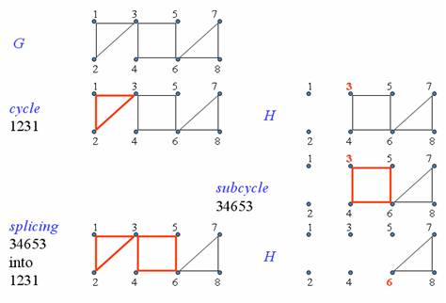
Example

Slide 29
Algorithm for Euler cycle using Stack
Algorithm Euler (G)
Input: Connected graph G with all vertices having even degrees
Output: Euler cycle
declare a stack S of characters
declare empty array E (which will contain Euler cycle)
push the vertex X to S
while (S is not empty){
ch = top element of the stack S
if ch is isolated then
remove it from the stack and put into E
else
select the first vertex Y (by alphabet order), which is adjacent to ch
push Y to S and remove the edge (ch, Y) from the graph
}
The last array E obtained is an Euler cycle of the graph

Slide 30
Theorem 2. Necessary and Sufficient
A connected multigraph has an Euler path but not an Euler cycle if and only if
It has exactly two vertices of odd degree

Slide 31
Hamiltonian Graphs
Hamilton Cycles and Paths

Slide 32
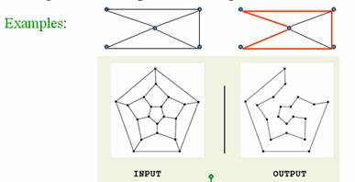
Definition
Hamilton path: visits every vertex of the graph exactly once.
Hamilton cycle: Visits every vertex of the graph exactly once before returning, as the last step, to the starting vertex.

Slide 33
Hamilton Cycles and Paths
No property is known to efficiently verify existence of a Hamilton cycle/path for general graphs.
The problem is known to be as difficult as the TSP (find the shortest H. cycle through n cities)
Dirac’s theorem: If G is a simple graph with n>=3 vertices such that the degree of every vertex is at least n/2, then G has a Hamilton cycle.
Ore’s Theorem: If G is a simple graph with n>= 3 vertices such that the deg(u) +d(v) >=n for every pair of nonadjacent vertices u and v, then G has a Hamilton cycle.
Theorem: If G=(V, E) is a complete directed graph then G has a Hamilton Cycle.
Notes:
TSP: Travelling salesman problem
A simple graph: A simple graph, also called a strict graph, is an unweighted, undirected graph containing no graph loops or multiple edges. Unless stated otherwise, the unqualified term “graph” usually refers to a simple graph
A complete graph is a graph where every pair of vertices is connected by an edge

Slide 34
Find Hamilton’s cycle using backtracking
Given the graph G=(V, E) and X is a vertex of G.
Suppose there exists at least one Hamilton cycle for the graph.
The following is a backtracking algorithm for finding one Hamilton cycle from the vertex X.
Declare an empty array H (which will contain Hamilton cycle)
1. Put the vertex X to H
2. Check if H is a Hamilton cycle then stop, else go to 3.
3. Consider the last vertex Y in H
if there is/are vert(ex/ices) adjacent to Y
select an adjacent vertex Z and put to H
if there is no adjacent vertex
remove Y from H and denote it as bad selection
(so you do not select it in the same way again)
Goto 2.

Slide 35
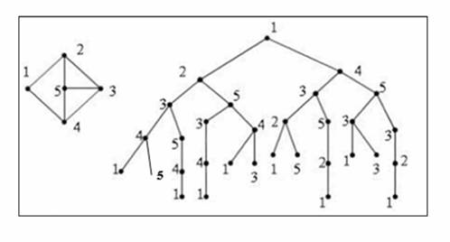
Example: Hamilton cycle enumeration

Slide 36
Graph Coloring

Slide 37
Graph Coloring
In graph theory, graph coloring is a way of coloring the vertices of a graph such that no two adjacent vertices share the same color.
If the chromatic number of graph G is denoted by X(G).
Graph for which k=X(G) is called k-colorable.
Chromatic number of a graph is the minimum number of colors one can use to color the vertices of the graph so that no two adjacent vertices have the same color.

Slide 38
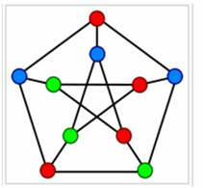
Graph coloring example

Slide 39
Sequential coloring
Establishes
A sequence of vertices and
A sequence of colors
And then
Color the next vertex with the lowest number possible.
sequentialColoringAlgorithm(graph=(V,E))
put vertices in a certain order Vp1, Vp2, …, Vpv;
put colors in a certain order C1, C2, …, Ck;
for i=1 to |V|
j=the smallest index of color that does not appear in neighbor of Vpi;
color(Vpi) = Cj.

Slide 40
Largest first
The higher degree a node has, the higher possibility it would be conflicted, so we should color it first.
Vertices should be organized so that vertices with high degrees should be placed at the beginning of the sequence
This is the largest first version of the algorithm

Slide 41
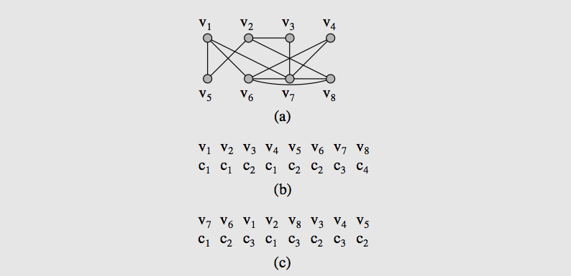
Example
Sequential
Largest first

Slide 42
Summaries
Graphs
Graph Representation
Graph Traversals
Connectivity
Cycle Detection
Shortest Paths
Dijsktra algorithm
Floyd algorithm
Bellman-Ford algorithm
Spanning Trees
Kruskal algorithm
Dijktra algorithm
Eulerian and Hamiltonian Graphs
Graph coloring
Reading at home
Notes:
Note: (*) Means that students are required to understand essential features only (the problem explanation, definitions, the outline of algorithms…), not in details.

Slide 43
Exercises
1
3
1
2
3
Find Minimum Spanning Tree
Using
Kruskal
Dijkstra
7
5
8
4
6
9
1
6
4
5
1
2
3
Find Minimum Number of Colors
Using
Sequential approach
Largest first approach
6
4
5

